Slide 1

Analysis Case Study

Slide 2

Table of contents

Slide 3

Business Objective and Business Task

Slide 4

Data Source, Licensing and Integrity

Slide 5

Visualizations to support key findings

Slide 6
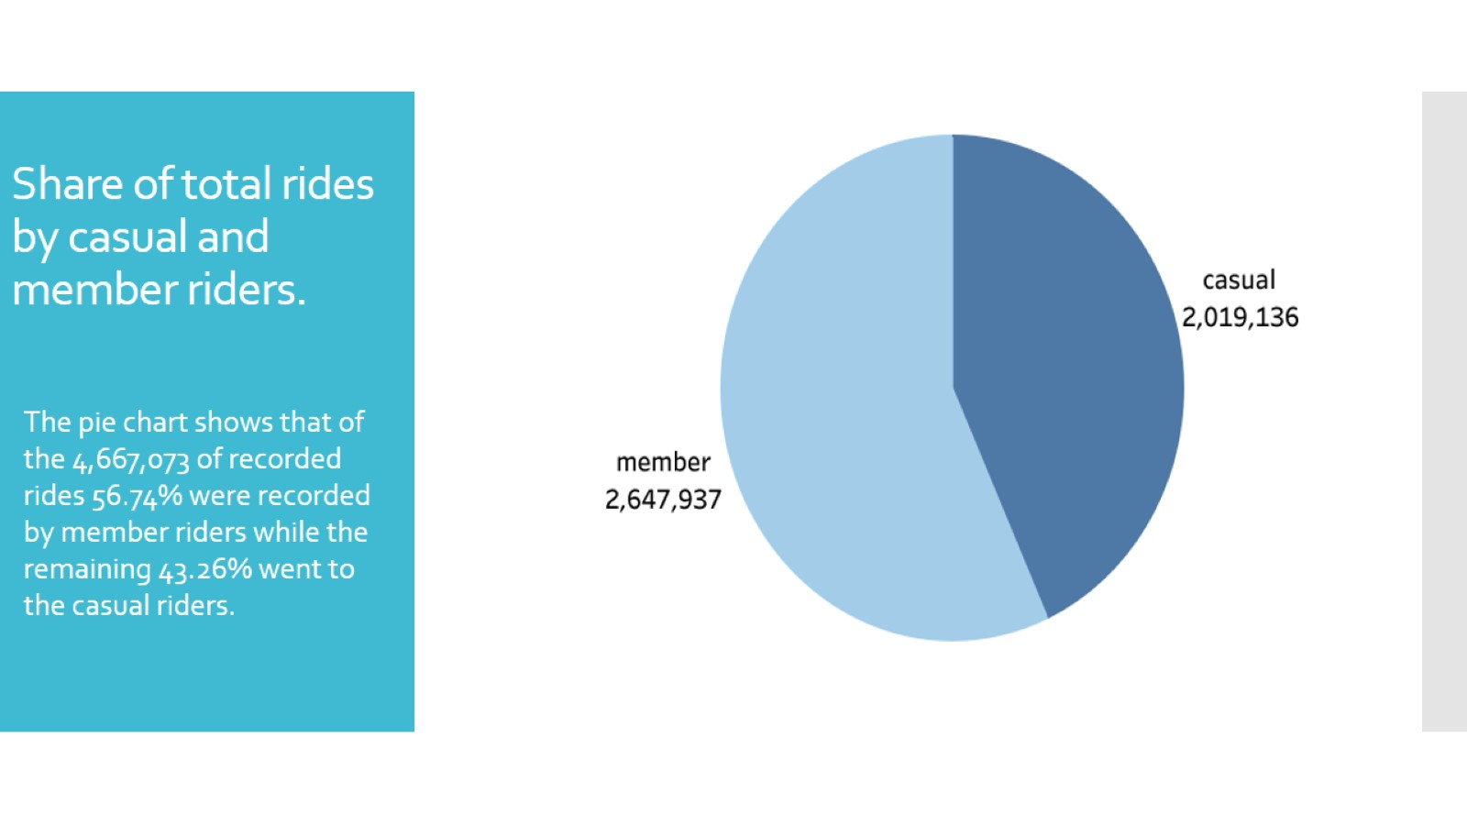
Share of total rides by casual and member riders.

Slide 7
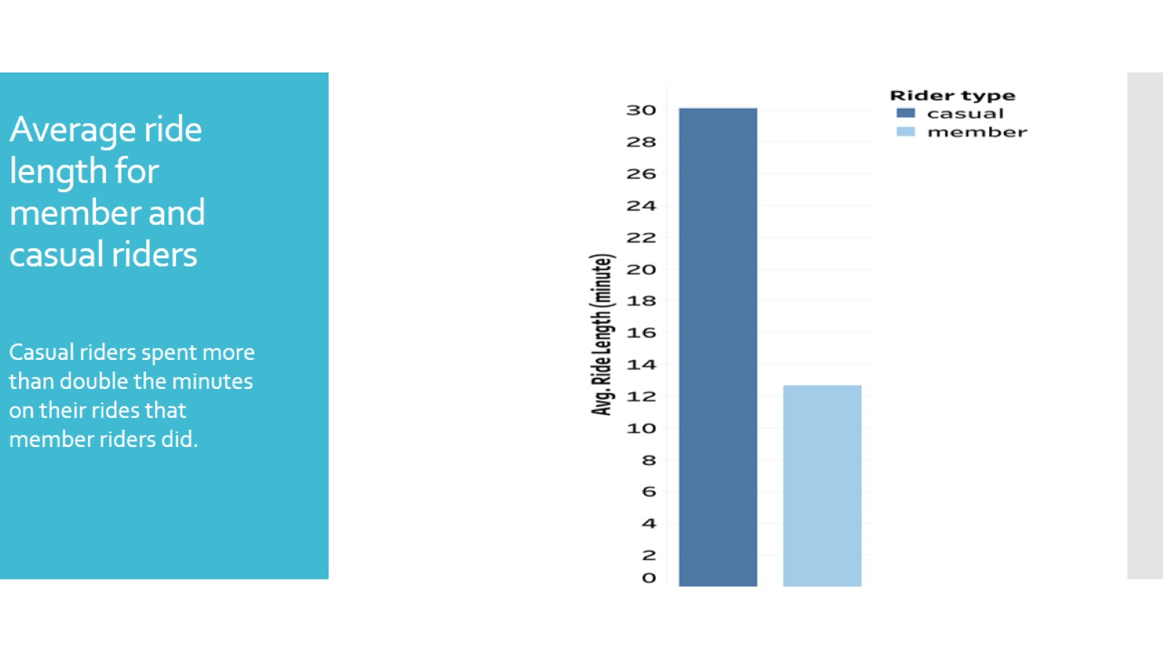
Average ride length for member and casual riders

Slide 8
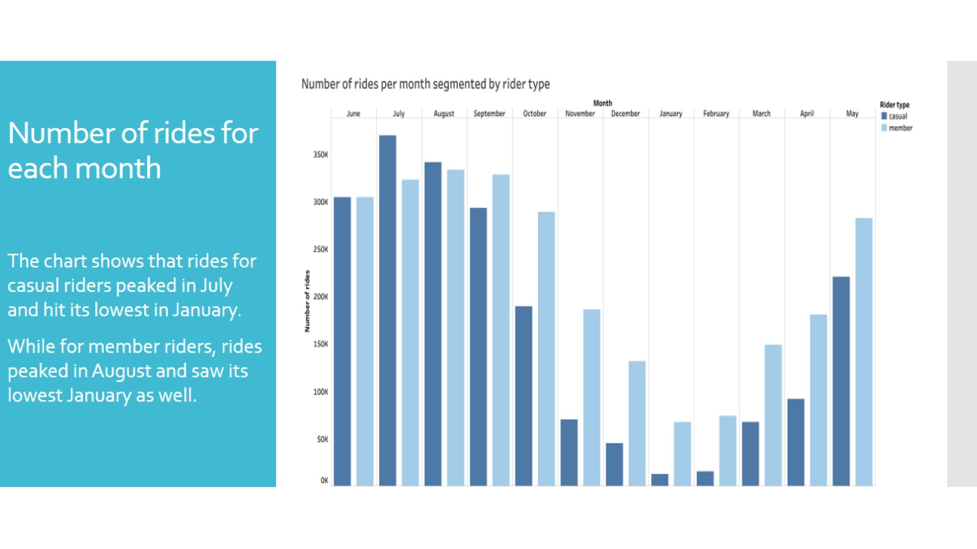
Number of rides for each month

Slide 9
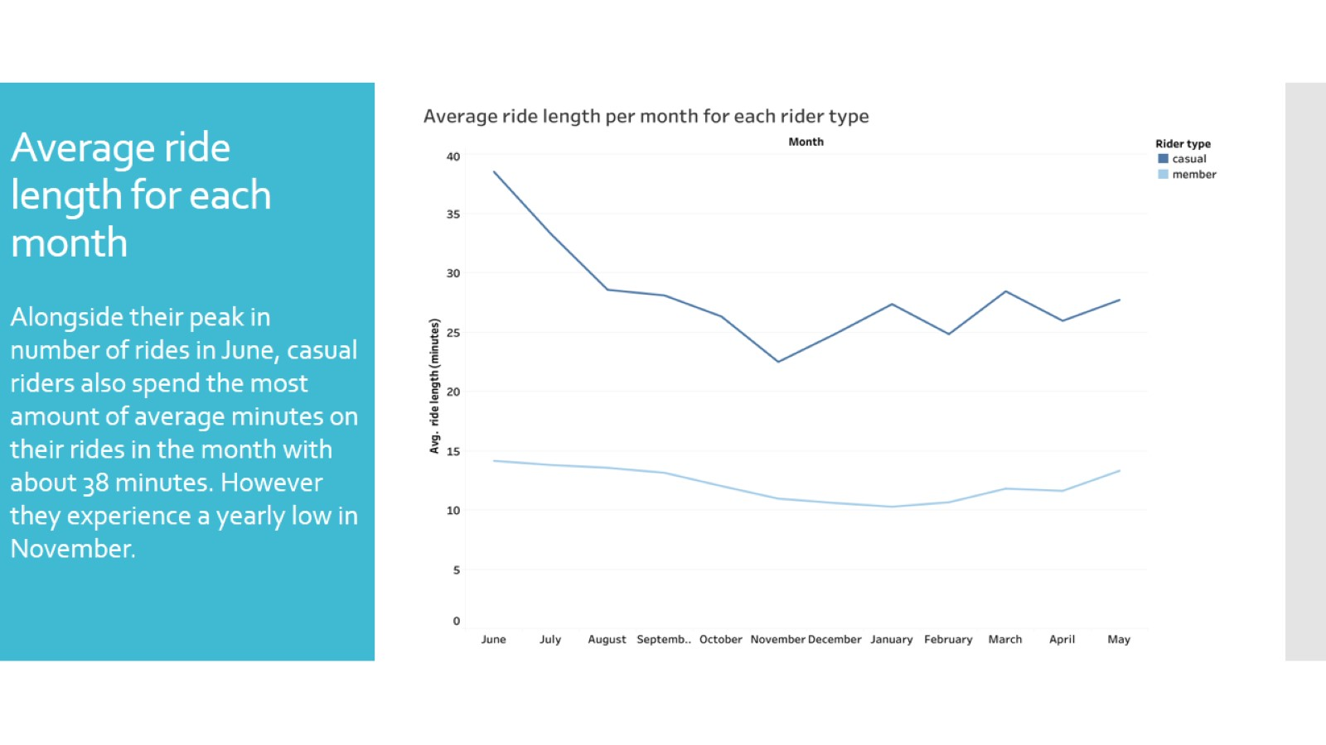
Average ride length for each month

Slide 10
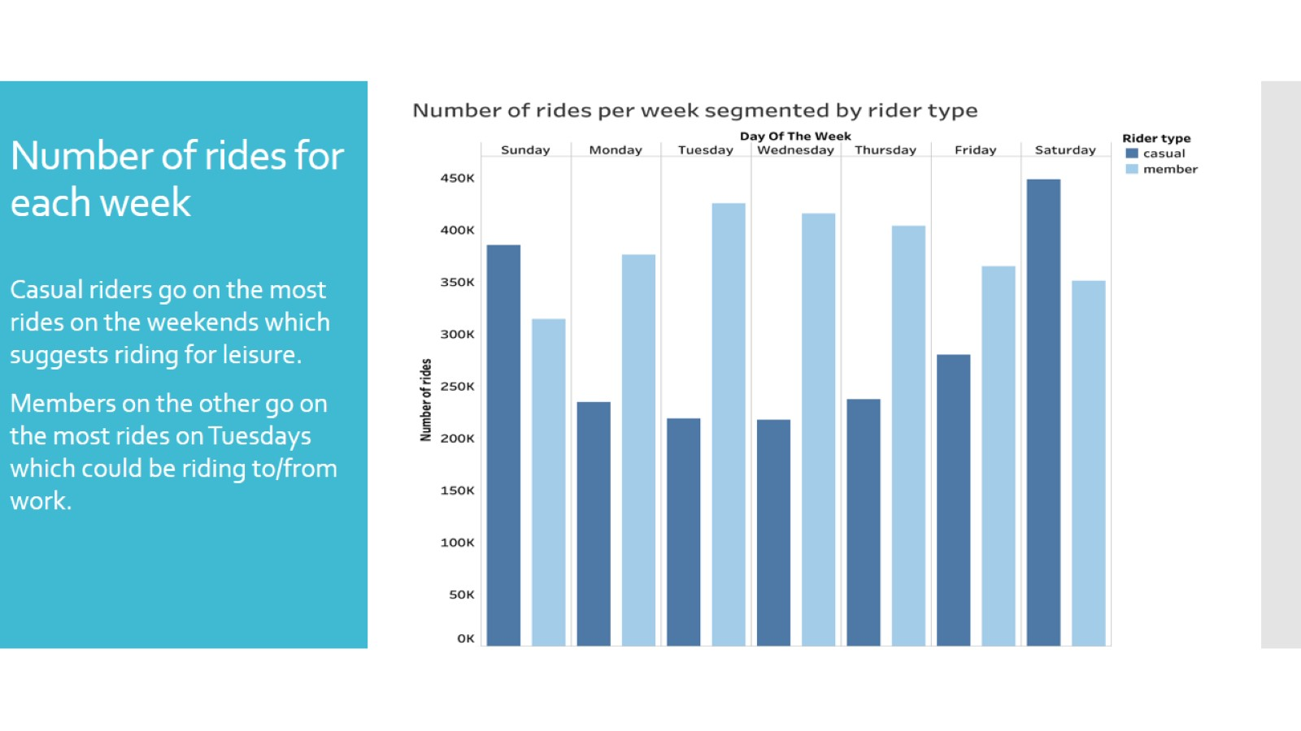
Number of rides for each week

Slide 11
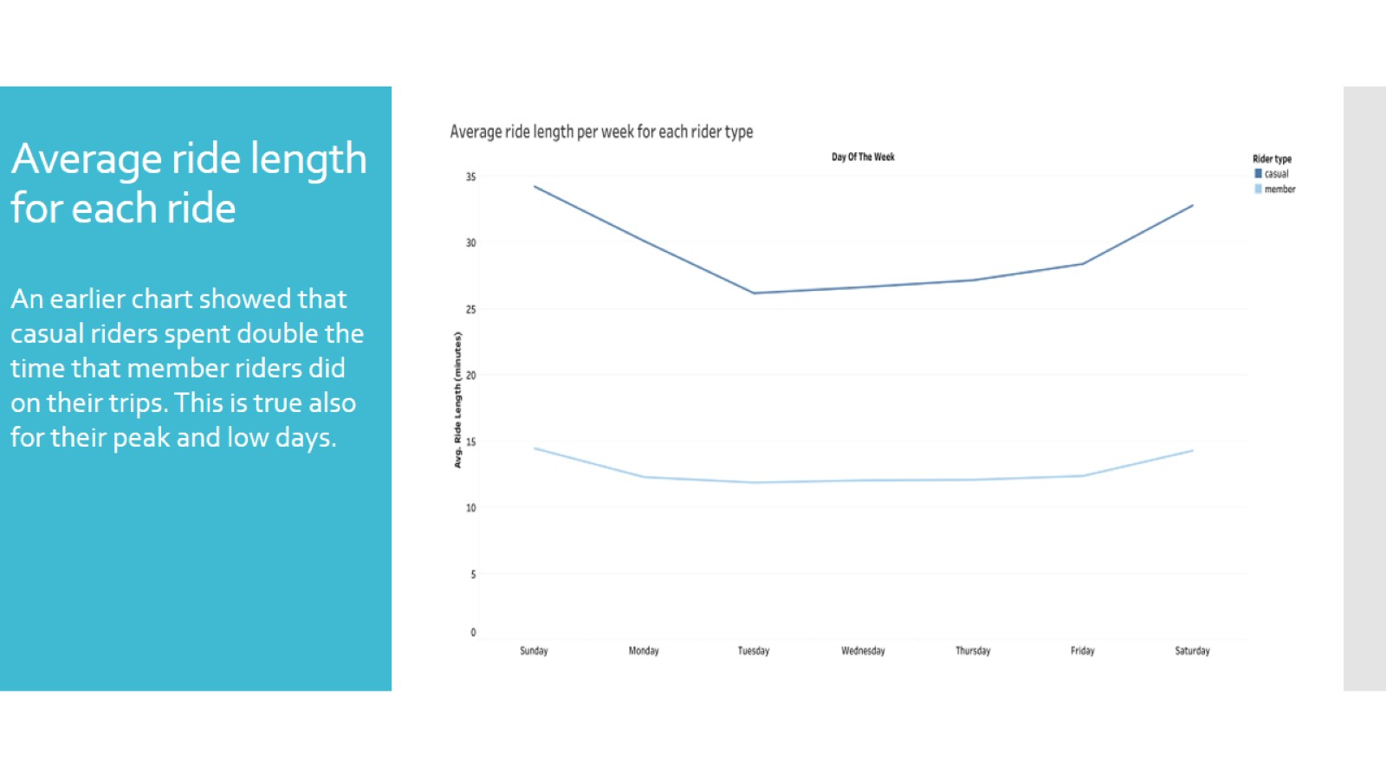
Average ride length for each ride

Slide 12
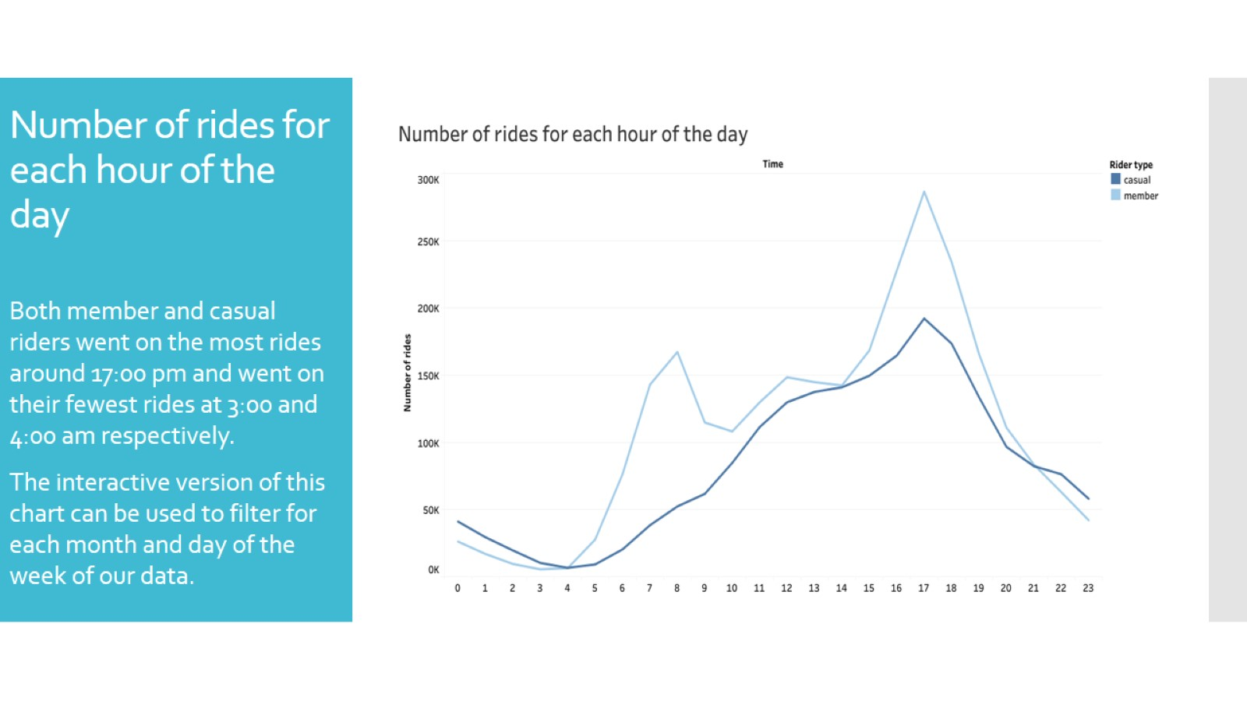
Number of rides for each hour of the day

Slide 13

Rideable type analysis

Slide 14
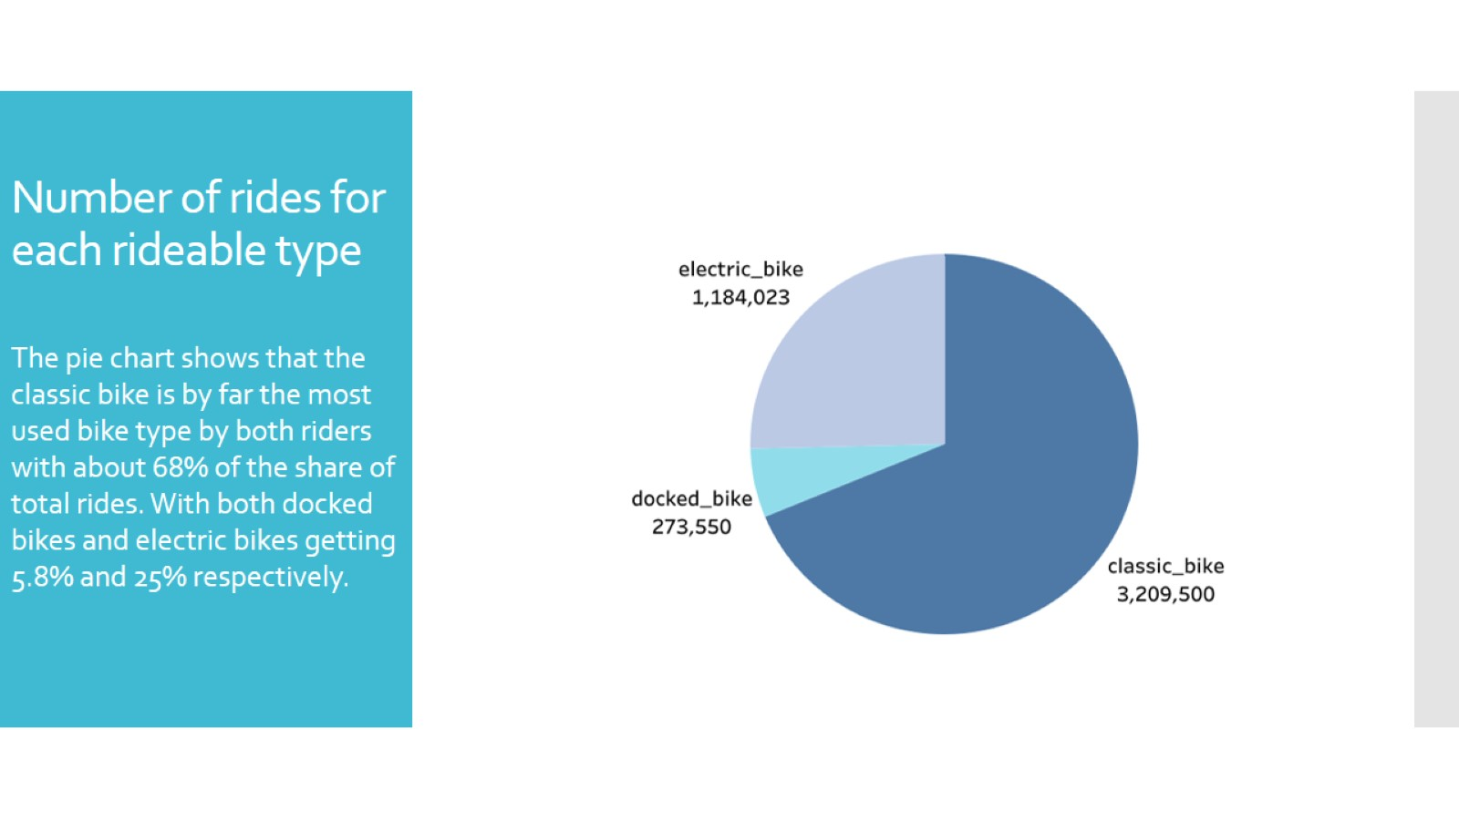
Number of rides for each rideable type

Slide 15
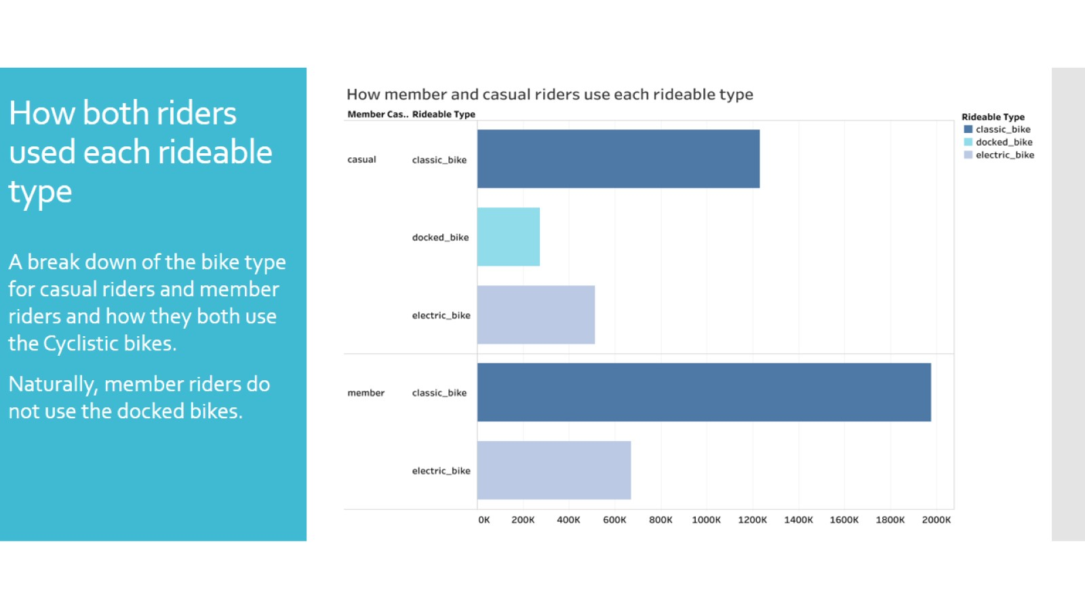
How both riders used each rideable type

Slide 16

Station analysis

Slide 17
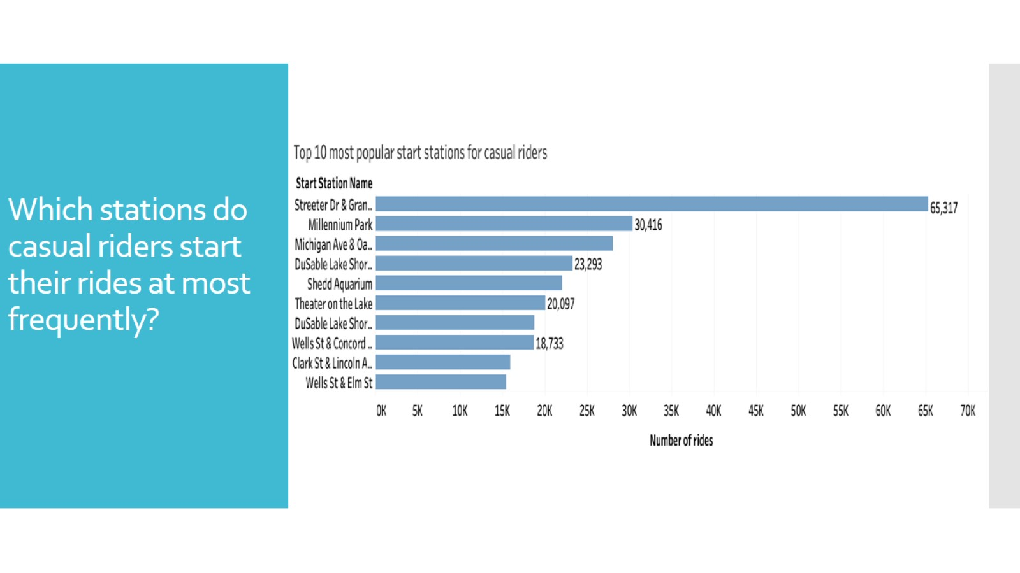
Which stations do casual riders start their rides at most frequently?

Slide 18
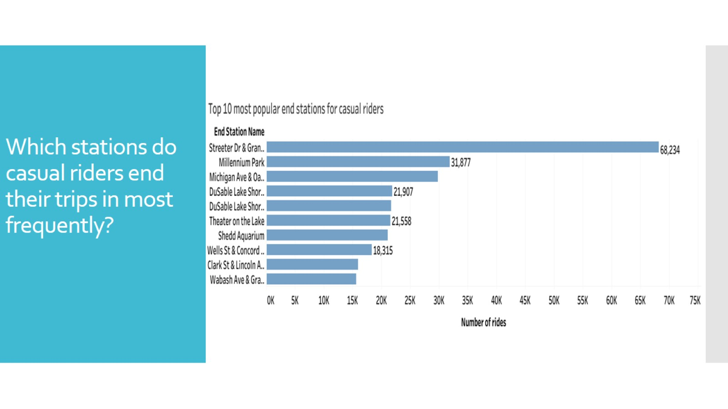
Which stations do casual riders end their trips in most frequently?

Slide 19
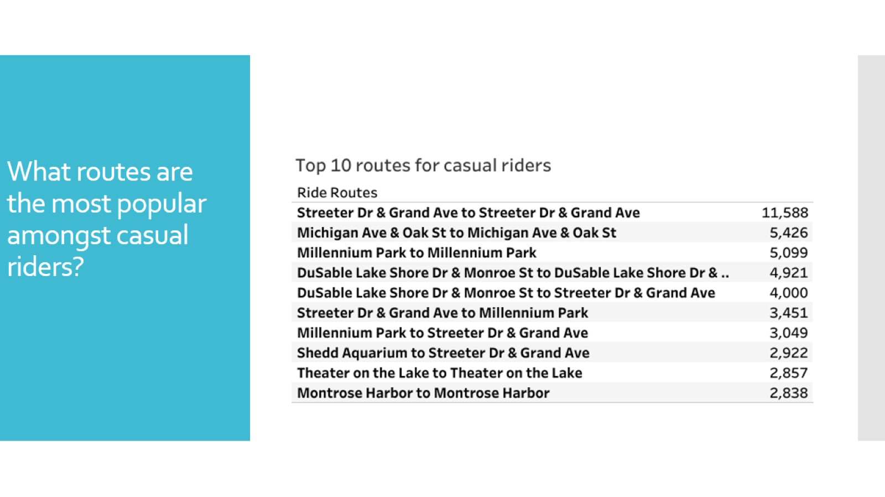
What routes are the most popular amongst casual riders?

Slide 20
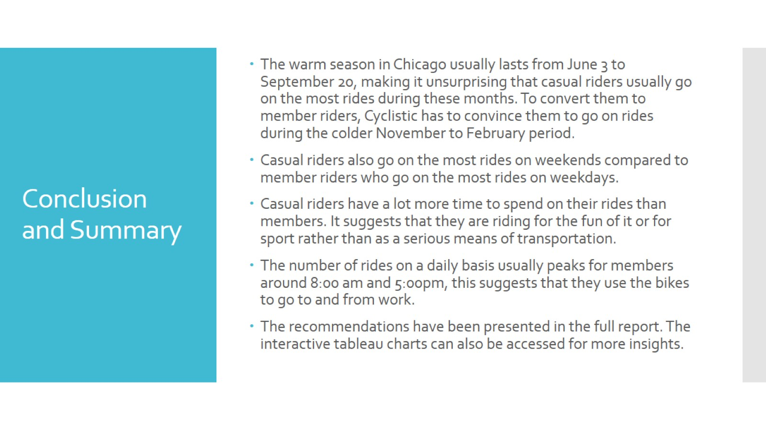
Conclusion and Summary

Slide 21

THE END

